Slide 1

The Art of Storytelling:
Bringing science and curiosity to life

Slide 2

Keys to Effective Data-Telling
Keep your audience in mind
The goal of analysis is to communicate something to Someone; keep that Someone top of mind when choosing the charts, graphs and communication method you are using
Focus on the insights and goals of the analysis
Use your research questions to guide the final communication. The correct chart types are the ones that will be the easiest for your audience to interpret
Support with text
Every slide and every chart needs a title, every axis needs a label. It should be clear what the audience is looking at. Supplement the chart with callouts or a single sentence that captures the essence of the message. If you want your audience to draw a specific conclusion, state it explicitly

Slide 3
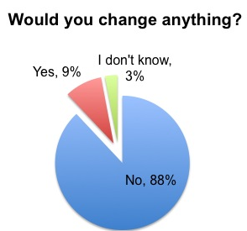
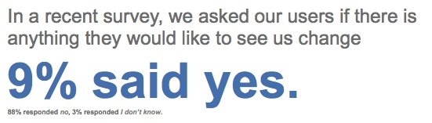
Keys to Effective Data-Telling
Good
Better

Slide 4
Keys to Effective Data-Telling
Aim for simplicity
You don’t need 125 slides to prove your point, nor do you need intensely complicated visuals. Sometimes a single number in large font is the most powerful way to convey your point
Use color strategically
Color is a strong visual cue to help your audience understand where they should focus their attention. Use it strategically to highlight the important parts of your visual. In general, aim to use a color palette of shades of grey with pointed use of color

Slide 5
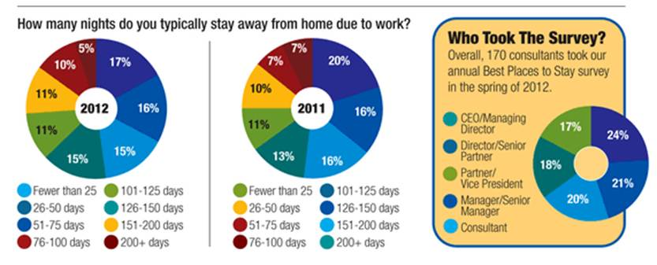
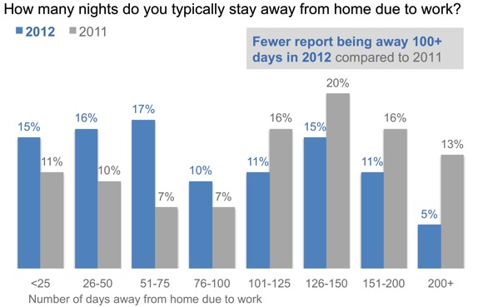
Keys to Effective Data-Telling
Good
Better

